Slide 1
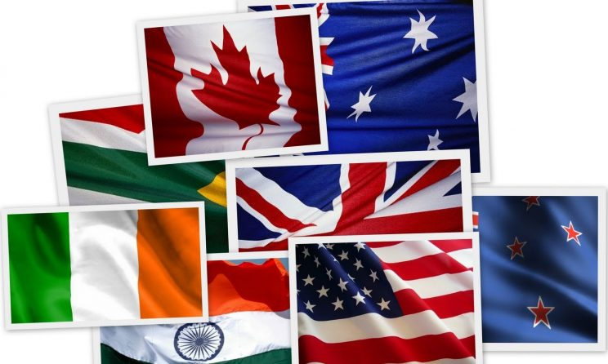
Wielcy ludzie kultury krajów anglojęzycznych
Julia Warmińska

Slide 2
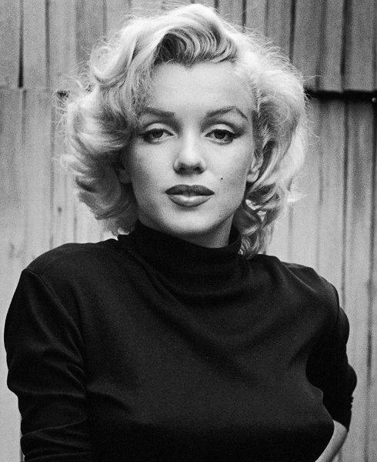
MARILYN mONROE
Marilyn Monroe was an American actress, writer ,model ,singer and filmmaker. She made 44 movies. Marilyn was born on June 1 1926 in Los Angeles. She became famous, because she was a great model and singer. That's why she is still recognizable. She cooperated with the largest brands. Marilyn-often called a star is considered to be synonymous with America in the 1950s and 1960s.

Slide 3
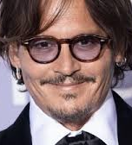
Johnny Depp
Johnny Depp is an American actor, producer and musician .Johnny was born in Kentucky on June 9,1963. He dropped out of school when he was 15, and he started creating a series of music-garage bands. Then he decided to go to an acting school in Los Angeles. He got a small part in the movie ,,Platon''. He became a star and a teen idol but he didn't like it.
Depp is one of the most popular actors in Hollywood. He can play any role. In 2003 he played the character of Jack Sparrow in the film ,,Pirates of the Caribbean".Thiis made him even more recognizable.

Slide 4
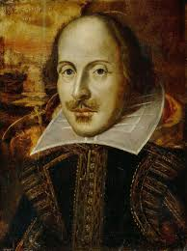
William shakespeare
William was an English poet and actor. He is regarded as one of the greatest writers of English literature. He wrote 38 plays,154 sonnets, and many pieces of other genres. His plays have been translated into every language. They also continue to be studied and reinterpreted. His most famous work is Romeo and Juliet.

Slide 5
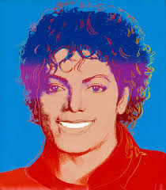
Michael jackson
Michael Joseph Jackson was an American singer, songwriter and dancer. He was one of the most famous musicians of all the time. People were calling him ,,King of Pop". He started his music career at the age of 6, with the family band ,,The Jackson 5". Michael was the youngest brother but his voice stood out the most. He was diagnosed with the skin disorder ,,albinism". People thought that he was purposely bleached his skin. Michael always said that he was not trying to be anything he was not. His songs have millions of views and the number is still growing. Jackson is the most awarded artist in the history of popular music.

