Slide 1
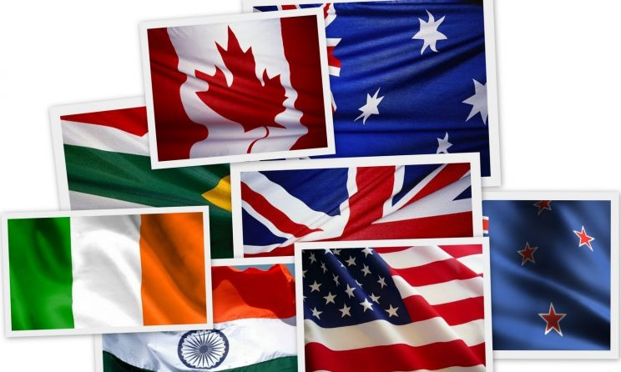
Wielcy ludzie krajów anglojęzycznych
Amelia Powroźnik 1AB

Slide 2
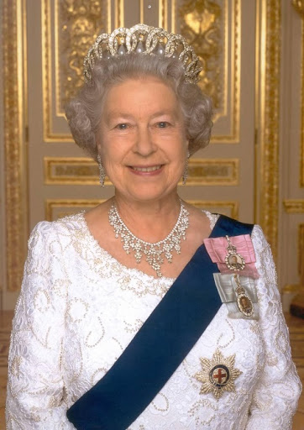
Elizabeth II (Elizabeth Alexandra Mary)
She was born on april 21, 1926 in London. She is the queen of Great Britain of the Windsor Dynasty from 6 February 1952. She is the daughter of King George IV and Elizabeth Bowes-Lyon. She is the longest-serving female head of state in world history, and the world's oldest living monarch, longest-reigning current monarch, and oldest and longest-serving current head of state. She is patron of over 600 organisations and charities. She likes a very different hobbies but the most important are equestrianism and dogs. Elizabeth achieved many titles or honours. For example : order of the British Empire, order of Companions of Honor, order of Outstanding Service.

Slide 3
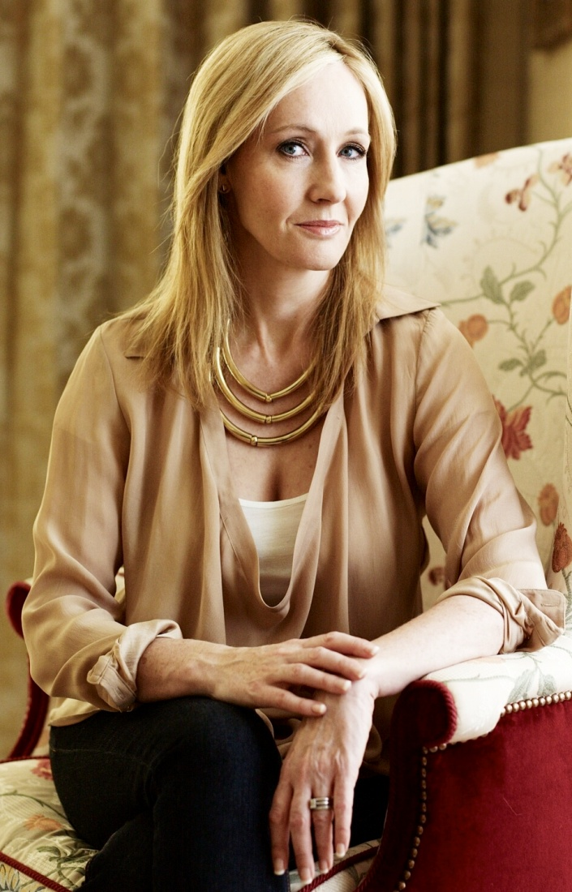
J.K. Rowling (Joanne Rowling)
She was born 31 July 1965. She is a British writer and philanthropis. She has written many outstanding books and the "Harry Potter" series. She also writes crime fiction under the pen name Robert Galbraith. The „Harry Potter” series has brought its author many great awards, and has sold over 500 million copies. She is also known from the „Cormoran Strike” series. And the other book is „The Casual Vacancy”. Joanne Rowling have a husband who is a Scottish doctor - Neil Murray. She have a 3 kids : David, Mackenzie and Jessica. Curiosity - she suffered from clinical depression when writing the Harry Potter series.

Slide 4
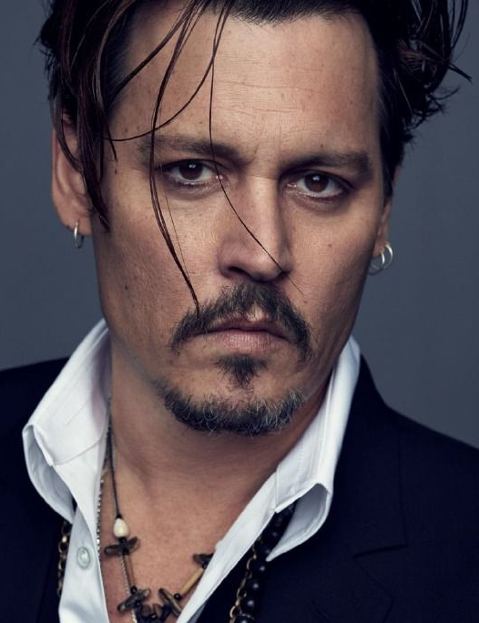
Johnny Depp (John Christopher Depp II)
He was born on June 9, 1963. He is an American actor, producer, and musician. He is one of the biggest movie stars in the world. His films earned over $ 3.7 billion in the United States and over $ 10 billion worldwide. He has been nominated for ten Golden Globe Awards, winning one for Best Actor for his performance of the title role in ”Sweeney Todd: The Demon Barber of Fleet Street” , and has been nominated for three Academy Awards for Best Actor. He has been listed in the 2012 ”Guinness World Records” as the world's highest-paid actor.

Slide 5
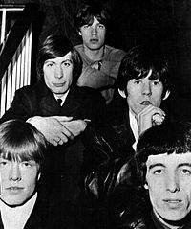
The Rolling Stones
They are british rock band, founded on July 12, 1962 in London. Composed of Charlie Watts, Ronnie Wood, Mick Jagger, and Keith Richards. Their UK releases include: The Rolling Stones, The Rolling Stones No. 2, Out of Our Heads, Aftermath. They have performed in Poland 4 times. Three times in Warsaw, once in Chorzów.

Slide 6
End. Thank you for attetion.

